Slide 1


Chirayu
02/14/2025

Slide 2

Outline
Executive Summary
Introduction
Methodology
Results
Conclusion
Appendix

Slide 3
Executive Summary
We analyzed factors affecting success/failure of SPACEX missions in this exercise
We performed Data procurement, data processing, visualization and predictions
We identified factors affecting mission success/failure
We identified factors most important in success/failure prediction of missions

Slide 4
Introduction
Project background and context
This project was to analyze SPACEX launch data to study relationships between several variables such as Rocket Payload, Payload Mass, etc with Success/Failure of mission
Problems you want to find answers
Are there any variables that are better suited to predict whether a lauch will result in success or Failure

Slide 5

Section 1

Slide 6
Methodology
Executive Summary
Data collection methodology:
Data was downloaded from SPACE X API (V4)
Perform data wrangling
Data was processed in several steps
Perform exploratory data analysis (EDA) using visualization and SQL
Perform interactive visual analytics using Folium and Plotly Dash
Perform predictive analysis using classification models
How to build, tune, evaluate classification models
https://github.com/chirayug/ds_project.git

Slide 7
Data Collection
Describe how data sets were collected.
Data was collected from SPACEX API (v4)
You need to present your data collection process use key phrases and flowcharts
Following APIs were used
rockets_url = https://api.spacexdata.com/v4/rockets/
launchpad_url = https://api.spacexdata.com/v4/launchpads/
payloads_url = https://api.spacexdata.com/v4/payloads/
core_url = https://api.spacexdata.com/v4/cores/
main_url = https://api.spacexdata.com/v4/launches/past
static_json_url='https://cf-courses-data.s3.us.cloud-object-storage.appdomain.cloud/IBM-DS0321EN-SkillsNetwork/datasets/API_call_spacex_api.json'
https://github.com/chirayug/ds_project.git

Slide 8
Data Collection – SpaceX API
API
JSON
NORMALIZE
DATE/TIME CONVERSION
MERGE
REMOVE NULL
ONE HOT CODING
Present your data collection with SpaceX REST calls using key phrases and flowcharts
Repository with code is available at
https://github.com/chirayug/ds_project.git
https://github.com/chirayug/ds_project.git

Slide 9
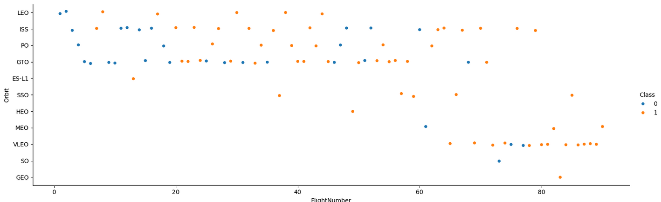
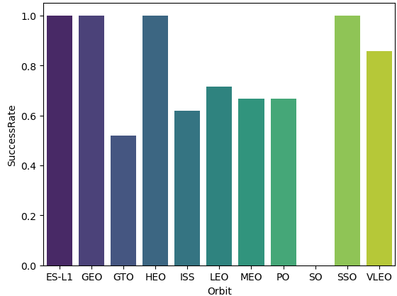
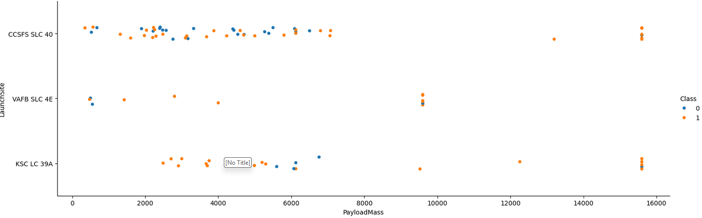
EDA with Data Visualization
https://github.com/chirayug/ds_project.git

Slide 10
EDA with SQL
Following queries were performed for analysis
%sql select * from SPACEXTABLE where Launch_Site like 'CCA%' limit 5
%sql select sum(PAYLOAD_MASS__KG_) from SPACEXTABLE where Customer = 'NASA (CRS)’
%sql select avg(PAYLOAD_MASS__KG_) from SPACEXTABLE where Booster_Version = 'F9 v1.1’
%sql select min(Date) from SPACEXTABLE where Landing_Outcome = 'Success (ground pad)’
%sql select distinct(Booster_Version) from SPACEXTABLE where Landing_Outcome = 'Success (drone ship)' and PAYLOAD_MASS__KG_ between 4000 and 6000
https://github.com/chirayug/ds_project.git

Slide 11
Build an Interactive Map with Folium
Summarize what map objects such as markers, circles, lines, etc. you created and added to a folium map
I used markers, circles and lines for launc sites, success/failure clusters, and nearest landmarks to calculate distances
https://github.com/chirayug/ds_project.git

Slide 12
Build a Dashboard with Plotly Dash
Summarize what plots/graphs and interactions you have added to a dashboard
I added percent launch success/failures, by site, also filterable by payload mass to the plot. This helps us visualize total success/failures, success/failures by launch site, and further for each launch site, by payload mass.
https://github.com/chirayug/ds_project.git

Slide 13
Predictive Analysis (Classification)
Summarize how you built, evaluated, improved, and found the best performing classification model
CLASSIFIED LAUNCHES TO SUCCESS/FAILURES
CREATED TRAIN TEST SPLIT
CREATED CLASSIFICATION MODELS
RAN PREDICTION
FOUND BEST PARAMETERS AND ACCURACY FOR EACH METHOD
CALCULATED SCORE FOR EACH METHOD
https://github.com/chirayug/ds_project.git

Slide 14
Results
Exploratory data analysis results
Interactive analytics demo in screenshots
Predictive analysis results
https://github.com/chirayug/ds_project.git

Slide 15

Section 2

Slide 16
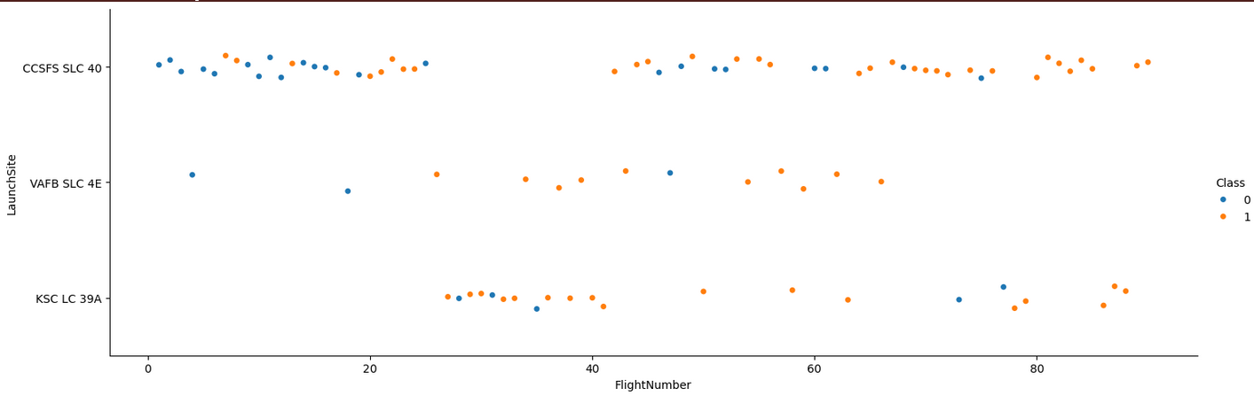
Flight Number vs. Launch Site
Show a scatter plot of Flight Number vs. Launch Site
This plot shows success/failures of consecutive flights. Initial flights had a mix, where as recent flights have been all successful irrespective of launch site

Slide 17
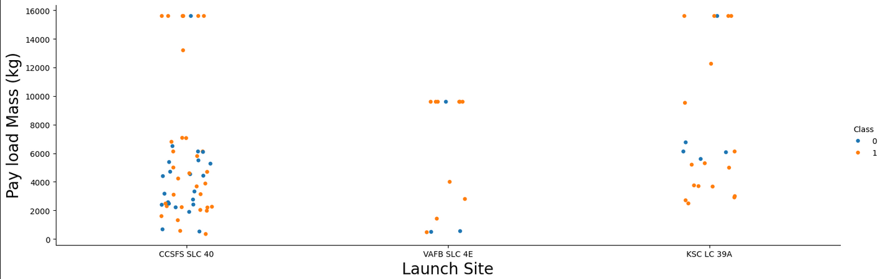
Payload vs. Launch Site
Show a scatter plot of Payload vs. Launch Site
Show the screenshot of the scatter plot with explanations

Slide 18
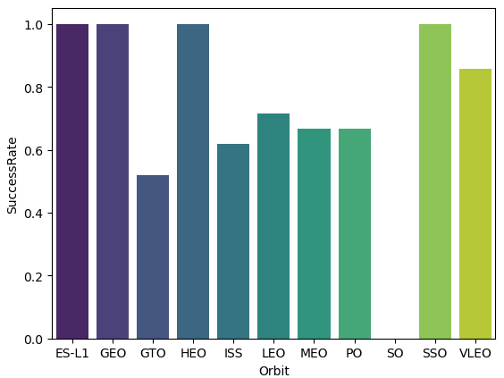
Success Rate vs. Orbit Type
Show a bar chart for the success rate of each orbit type
This graph shows that some orbits have a 100% success rate (e.g., ES-L1, GEO) whereas some (e.g., GTO) have almost half failure rate

Slide 19
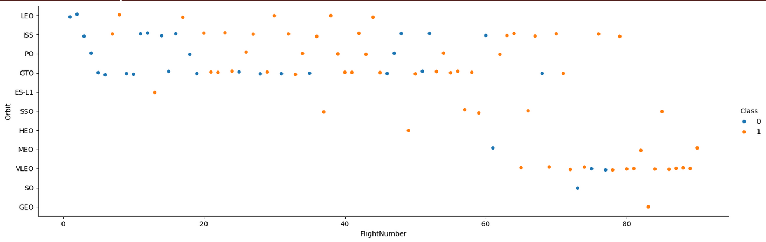
Flight Number vs. Orbit Type
Show a scatter point of Flight number vs. Orbit type
This plot shows a pattern change in orbit selection between old and recent flights with most recent ones being VLEO with high success rate.

Slide 20
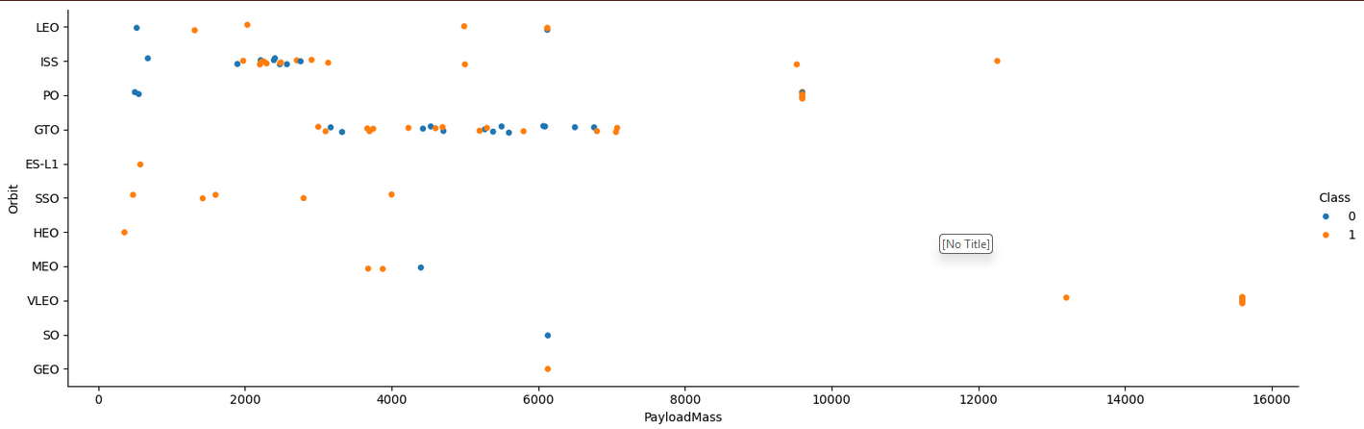
Payload vs. Orbit Type
Show a scatter point of payload vs. orbit type
Higher payloads seem to have better success rates in any specific orbit types
Some orbits such as ISS and GTO have mixed success rates.

Slide 21
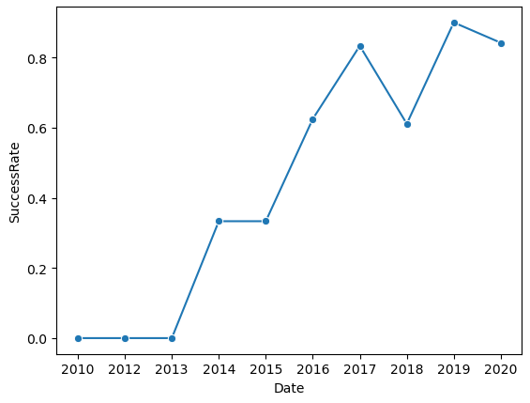
Launch Success Yearly Trend
Show a line chart of yearly average success rate
This graph shows increase in success rate with passing of time.

Slide 22
All Launch Site Names
Find the names of the unique launch sites
%sql select distinct Launch_Site from SPACEXTABLE
Present your query result with a short explanation here
These are the 4 Launch sites in the data
Launch_Site
CCAFS LC-40
VAFB SLC-4E
KSC LC-39A
CCAFS SLC-40

Slide 23
Launch Site Names Begin with 'CCA'
Find 5 records where launch sites begin with `CCA`
Present your query result with a short explanation here
%sql select * from SPACEXTABLE where Launch_Site like 'CCA%' limit 5
Date | Time (UTC) | Booster_Version | Launch_Site | Payload | PAYLOAD_MASS__KG_ | Orbit | Customer | Mission_Outcome | Landing_Outcome
2010-06-04 | 18:45:00 | F9 v1.0 B0003 | CCAFS LC-40 | Dragon Spacecraft Qualification Unit | 0 | LEO | SpaceX | Success | Failure (parachute)
2010-12-08 | 15:43:00 | F9 v1.0 B0004 | CCAFS LC-40 | Dragon demo flight C1, two CubeSats, barrel of Brouere cheese | 0 | LEO (ISS) | NASA (COTS) NRO | Success | Failure (parachute)
2012-05-22 | 7:44:00 | F9 v1.0 B0005 | CCAFS LC-40 | Dragon demo flight C2 | 525 | LEO (ISS) | NASA (COTS) | Success | No attempt
2012-10-08 | 0:35:00 | F9 v1.0 B0006 | CCAFS LC-40 | SpaceX CRS-1 | 500 | LEO (ISS) | NASA (CRS) | Success | No attempt
2013-03-01 | 15:10:00 | F9 v1.0 B0007 | CCAFS LC-40 | SpaceX CRS-2 | 677 | LEO (ISS) | NASA (CRS) | Success | No attempt

Slide 24
Total Payload Mass
Calculate the total payload carried by boosters from NASA
%sql select sum(PAYLOAD_MASS__KG_) from SPACEXTABLE where Customer = 'NASA (CRS)’
Present your query result with a short explanation here
They key is to use aggregation function ‘sum’ in the query, and limiting the Customer to NASA (CRS)
Total Payload Mass for NASA CRS Rockets was 45596 KG
TOTAL PAYLOAD MASS
45596

Slide 25
Average Payload Mass by F9 v1.1
Calculate the average payload mass carried by booster version F9 v1.1
Present your query result with a short explanation here
%sql select avg(PAYLOAD_MASS__KG_) as `F9v1.1 PAYLOAD` from SPACEXTABLE where Booster_Version = 'F9 v1.1’
Average Payload for F9 v1.1 booster was 2534 KG
F9v1.1 AVG PAYLOAD
2534.6666666666665

Slide 26
First Successful Ground Landing Date
Find the dates of the first successful landing outcome on ground pad
%sql select min(Date) as `OLDEST LAUNCH DATE` from SPACEXTABLE where Landing_Outcome = 'Success (ground pad)'
Present your query result with a short explanation here
This query also uses the aggregation ‘min’ function to find oldest data of successful launch
OLDEST LAUNCH DATE
2015-12-22

Slide 27
Successful Drone Ship Landing with Payload between 4000 and 6000
List the names of boosters which have successfully landed on drone ship and had payload mass greater than 4000 but less than 6000
%sql select distinct(Booster_Version) as `BOOSTER VERSION` from SPACEXTABLE where Landing_Outcome = 'Success (drone ship)' and PAYLOAD_MASS__KG_ between 4000 and 6000
Present your query result with a short explanation here
BOOSTER VERSION
F9 FT B1022
F9 FT B1026
F9 FT B1021.2
F9 FT B1031.2

Slide 28
Total Number of Successful and Failure Mission Outcomes
Calculate the total number of successful and failure mission outcomes
%sql select count(*) as `SUCCESSFUL MISSIONS` from SPACEXTABLE where Mission_Outcome = 'Success’
%sql select count(*) as `FAILED MISSIONS` from SPACEXTABLE where Mission_Outcome <> 'Success'
Present your query result with a short explanation here
SUCCESSFUL MISSIONS
98
FAILED MISSIONS
3

Slide 29
Boosters Carried Maximum Payload
List the names of the booster which have carried the maximum payload mass
Present your query result with a short explanation here
%sql select distinct(Booster_Version) as `MAX PAYLOAD BOOSTERS` from SPACEXTABLE where PAYLOAD_MASS__KG_ = (select max(PAYLOAD_MASS__KG_) from SPACEXTABLE)
This query uses function distinct and a subquery.
Seems like F9 B5 version boosters have carried max palyload mass
MAX PAYLOAD BOOSTERS
F9 B5 B1048.4
F9 B5 B1049.4
F9 B5 B1051.3
F9 B5 B1056.4
F9 B5 B1048.5
F9 B5 B1051.4
F9 B5 B1049.5
F9 B5 B1060.2
F9 B5 B1058.3
F9 B5 B1051.6
F9 B5 B1060.3
F9 B5 B1049.7

Slide 30
2015 Launch Records
List the failed landing_outcomes in drone ship, their booster versions, and launch site names for in year 2015
Present your query result with a short explanation here
%sql select substr(Date, 6,2) as 'Month', substr(Date,0,5) as 'Year' from SPACEXTABLE where substr(Date,0,5) = '2015' and Landing_Outcome like 'Failure%' limit 5
Results show in year 2015, only months of Jan and Apr had Failures
Month | Year
01 | 2015
04 | 2015

Slide 31
Rank Landing Outcomes Between 2010-06-04 and 2017-03-20
Rank the count of landing outcomes (such as Failure (drone ship) or Success (ground pad)) between the date 2010-06-04 and 2017-03-20, in descending order
Present your query result with a short explanation here
The results show that No Attempt was the major Landing Outcome of missions between 2010-06-04 and 2017-03-20, followed by Drone Ship Success. Least frequent outcome was Precluded (Drone Ship)
Landing_Outcome | OUTCOME
No attempt | 10
Success (drone ship) | 5
Failure (drone ship) | 5
Success (ground pad) | 3
Controlled (ocean) | 3
Uncontrolled (ocean) | 2
Failure (parachute) | 2
Precluded (drone ship) | 1

Slide 32

Section 3

Slide 33
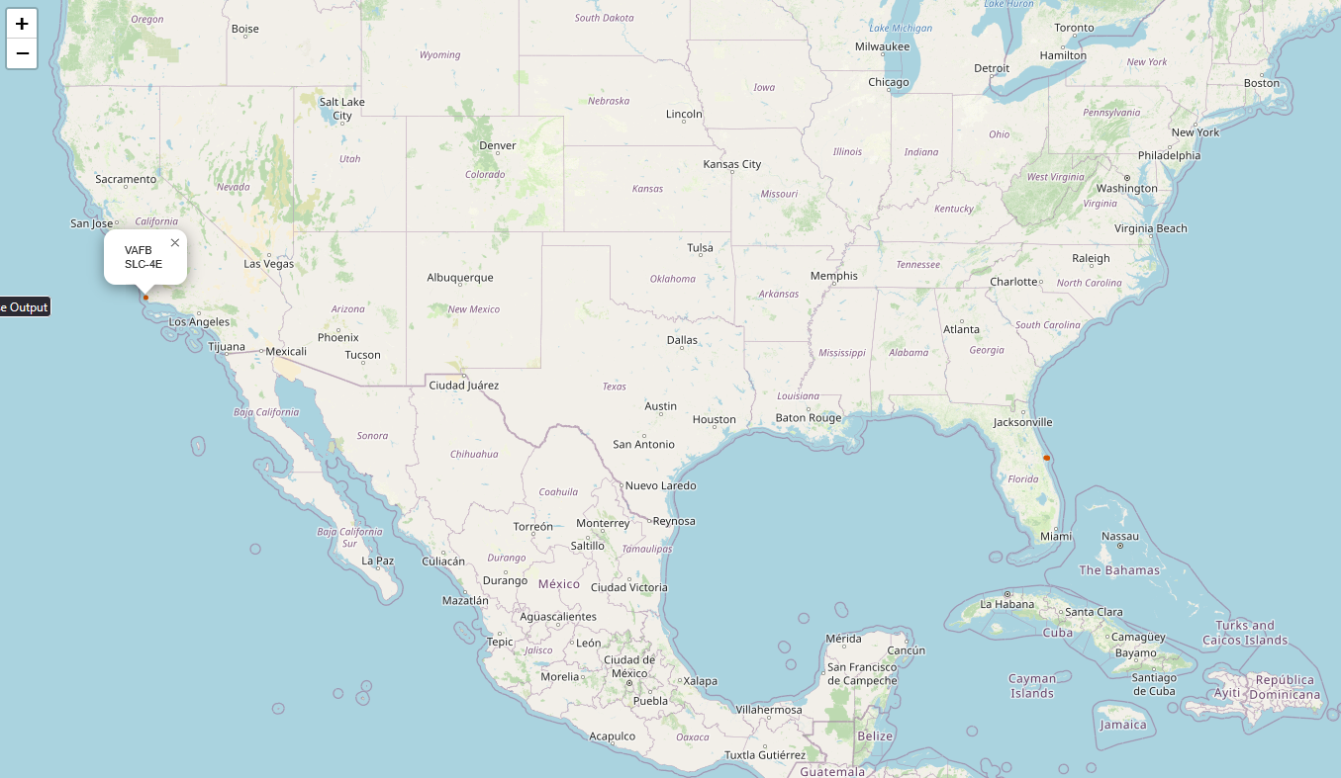
Launch Site Locations
Launch sites are mainly located on East or West Coast

Slide 34
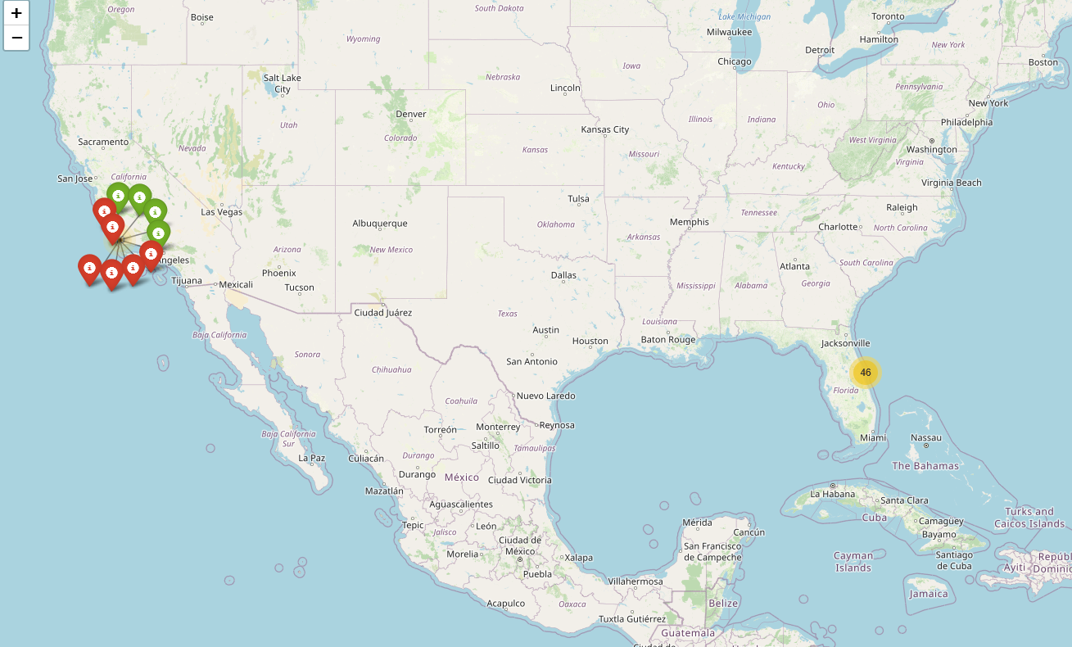
Success/Failure for Launc Sites
Replace <Folium map screenshot 2> title with an appropriate title
Explore the folium map and make a proper screenshot to show the color-labeled launch outcomes on the map
Map shows Success (green) and Failure(red) outcomes of launches from California site

Slide 35
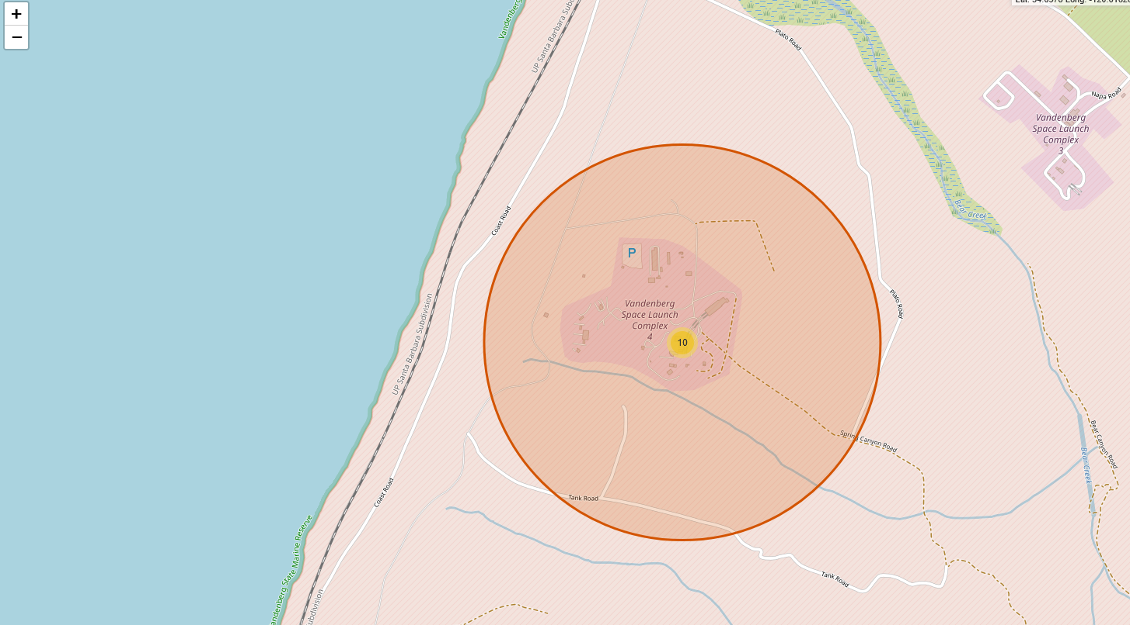
Landmarks near California Launch Site
Launch Site VAFB SLC-4E Proximity to Landmarks
Distance between launcsite and nearest coastline is 1.390 Km

Slide 36

Section 4

Slide 37
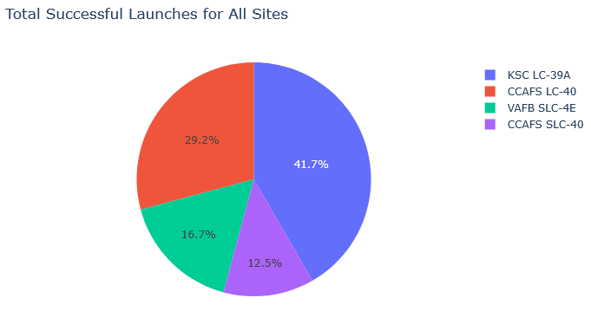
Success/Failure per site
The piechart shows success rate for different sites
Site KSC has highest success rate which site CCAFS has least.

Slide 38
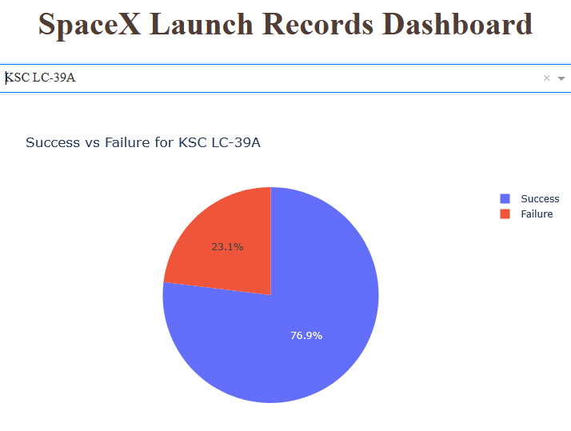
Highest success site
Site KSC LC-39A has 77% Success rate

Slide 39
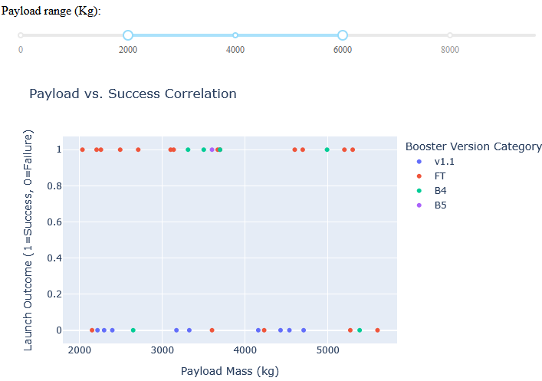
Payload vs Success Correlation
Figure displays plot for all launch sites for payload between 2000 and 6000 KGs

Slide 40

Section 5

Slide 41
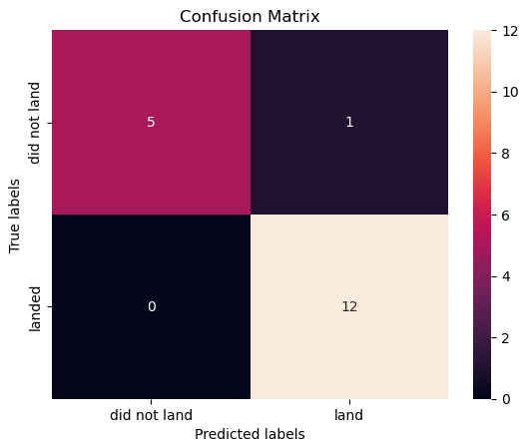
Classification Accuracy
Models Assesses
Logistic Regression
SVM
Decision Tree
K-Nearest Neighbor
Model with highest accuracy was SVM with a 94.44% accuracy

Slide 42
Confusion Matrix

Slide 43
Conclusions
Failure Rate depends on factors such as Orbit and payload mass
It was noticed though that recent launches have a success rate independent of payload mass
Some sites were noticed to have a higher success rate compared to others
Certain classifiers are better suited for predicting Success/Failure rate compared to others
In the model, SVM performed as best classifier for predicting success/failure rate

Slide 44
Appendix
Include any relevant assets like Python code snippets, SQL queries, charts, Notebook outputs, or data sets that you may have created during this project

Slide 45


